Slide 1
HUMN 351: Myth in the World
Course Project – Part 6

Slide 2
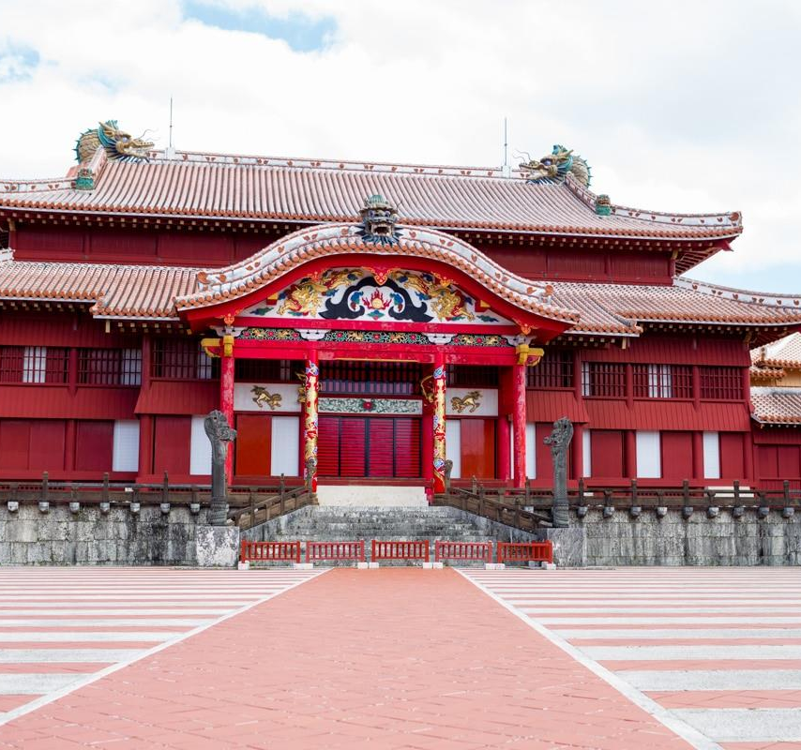
Introduction
Mythology & Culture of
The elderly of Okinawa, Japan
A bit of history:
Called Ryukyu Islands and
independent from Japan until 1872
Japan annexed the Ryukyu Islands
in 1879 officially renaming them
as Okinawa
China had great cultural influence
on the Ryukyu Islands up until Japan
invaded and annexed them

Slide 3
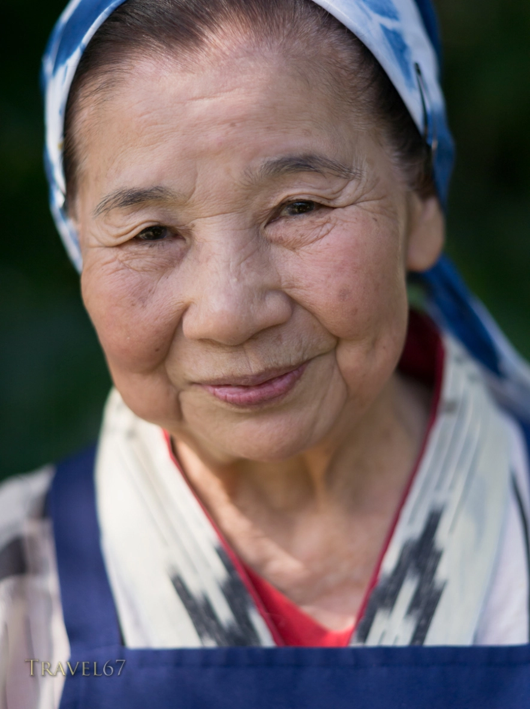
Identity
Healthy
Respected
Energetic
Long-lived
Traditional
Purposeful
Happy
Social
Philosophical
Hard-working
Notes:
The elderly of Okinawa, Japan are a very traditional type of people. From their way of life to the types of food they eat, Okinawans stick to their roots. Their main diet consists of foods such as pork, sweet potatoes, fish, grains, and lots of vegetables which keep them healthy. By not eating greasy foods, limiting alcohol consumption, and red meats, and instead eating foods that are good for the body, helps keep Okinawa’s elderly active and energetic. Since the elderly practice a healthy living, this type of lifestyle helps to contribute to the fact that there are more centurions living in Okinawa than any place in the world. These long-lived citizens are a well respected part of society and communities. Being philosophical and purposeful is a way to live a happy life for the elders of Okinawa. They believe in the philosophy of Ikigai, which is essentially having a sense of purpose. Finding a purpose in everything that you do, such as waking up, going to work, cleaning, you can live a happy and fulfilling life while limiting the everyday stressors to a minimum. With a positive outlook on life thanks to the philosophy of Ikigai, the elderly Okinawan’s work hard at their job and some even continue working well past 70 years old. Okinawa’s elderly are a hard-working and social group of people. They believe in having social gathering and trusting connections with others so that in times of need, they’ll have people whom they can trust to turn to.

Slide 4
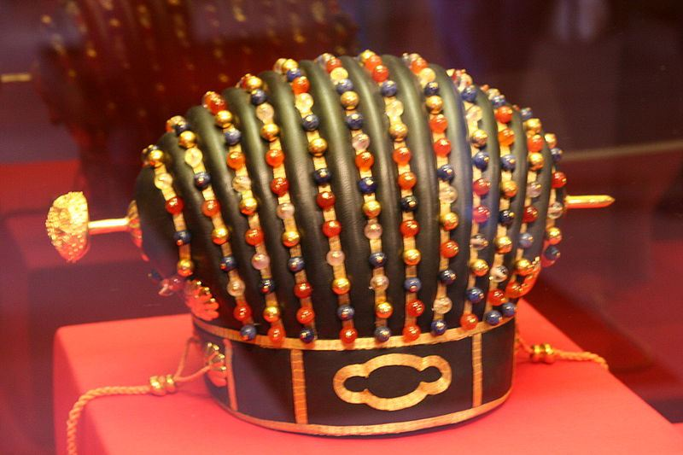
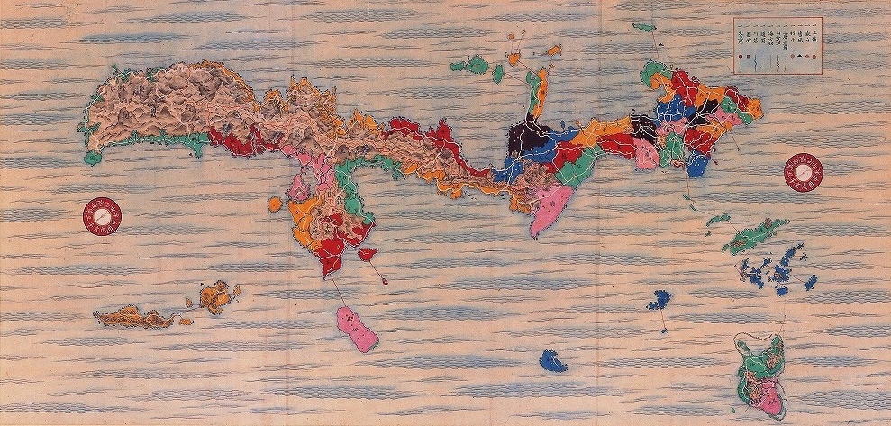
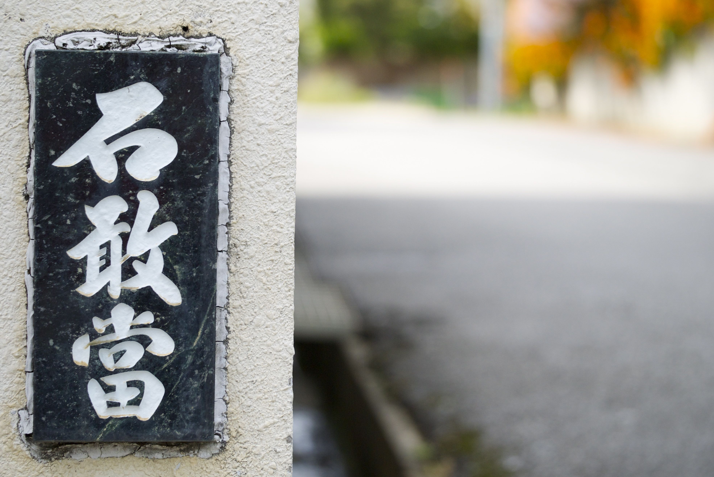
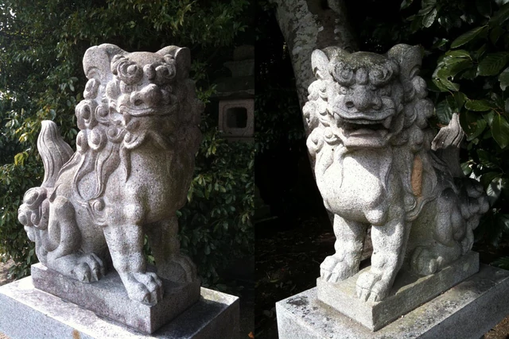
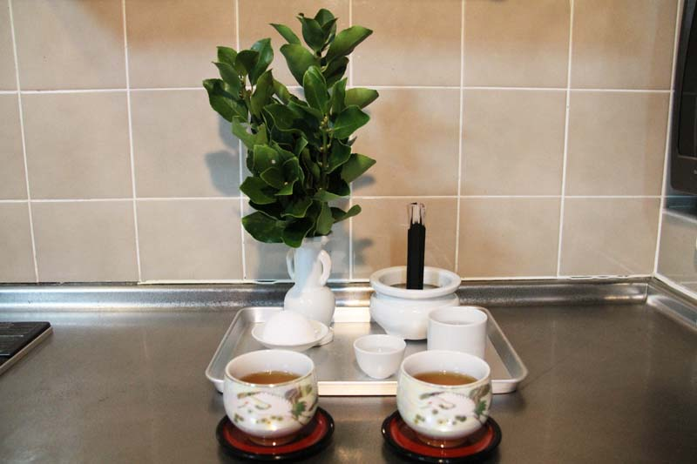
Material Culture
Ryukyu Investiture Crown
Objects have a great significance to the people of Okinawa. They are a physical representation of their beliefs and are an integral part of who the Okinawans are as a people and a vital part of their everyday lifestyle.
Given to the Ryukyu kings from the Chinese courts
Magiri-zu Maps
Ishiganto
Created during the Ryukyu Era
25 total maps depicting the Ryukyu Islands
Found at T and Y intersections
Will eliminate evil spirits if passed
Shisa Guards
Hinukan Altar
Paired lion-dogs usually found on rooftops or entryways
Keeps good spirits in and evil ones out
An altar to honor the fire diety Umichimon
Found in the kitchen
Notes:
One object that can be seen all over Okinawa and are probably one of the most important are the shisa guards. Usually placed at the front of the house or on rooftops, these lion-dogs are thought to keep bad spirits out and keep the good ones in. Shisa guards are found in pairs with one mouth open and the other one closed. The open mouth represent keeping the bad spirits out and the closed mouth represents keeping the good ones in.
Another object that you’ll find everywhere, are the ishigantos. These are charms, tablets, or simply writings that are placed at intersections because it’s believed that spirits can only move forward in a straight line. If evil spirits encounter the ishiganto, they will dissipate. You’ll also find the ishigantos on a house that is at an intersection. One story behind the ishiganto is that there was a great warrior who fought evil spirits and made a name for himself among the spirit world, and if spirits came across the ishiganto charms, they would flee for fear of the great warrior.
A hinukan, also known as umichimon, is a respected fire deity for which an altar to honor the deity can usually be found in the kitchen of an Okinawan home. The oldest female of the household maintains the altar and prays to the fire god for good fortune and protection over her family.
One object of historical significance is the Ryukyu Investiture crowns. Before Japan annexed Okinawa, the islands were called Ryukyu Islands and were under Chinese influence. The crowns were given to the Ryukyu kings from the Chinese courts.
Another object that has a historical significance to the people of Okinawa are the Magiri-zu maps. These maps were drawn out during their ever-so-important Ryukyu Era. Twenty-five maps were made depicting the islands of Ryukyu and only a few are left today due to war and conflict as the maps were either stolen or destroyed.

Slide 5
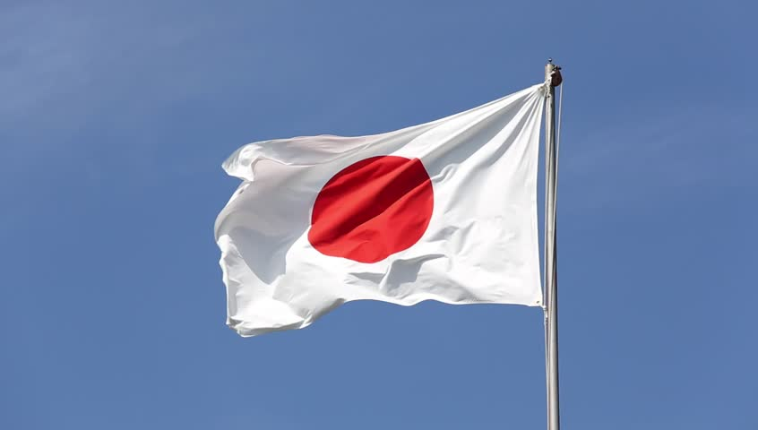
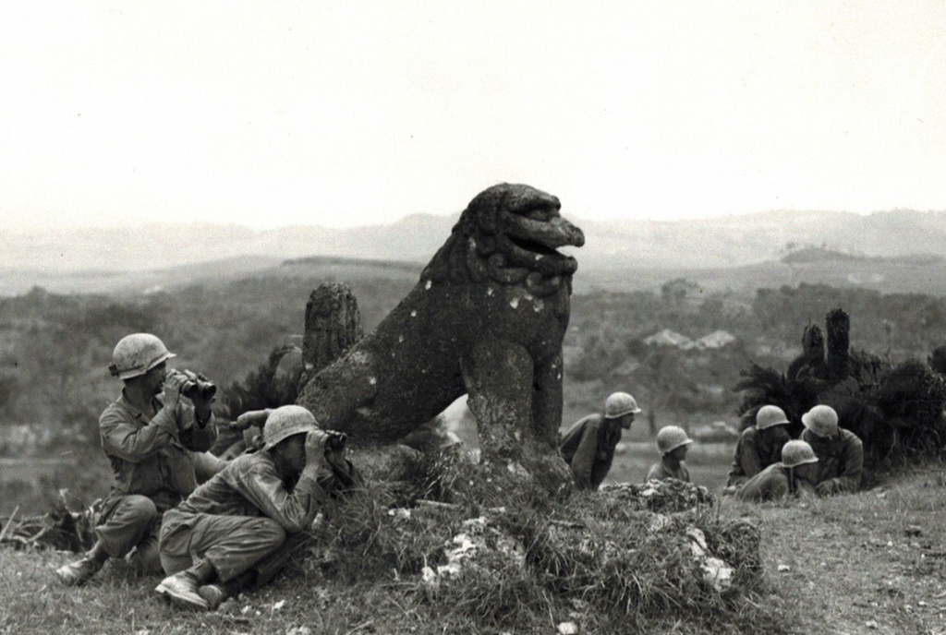
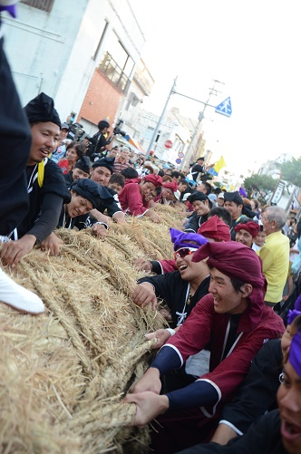
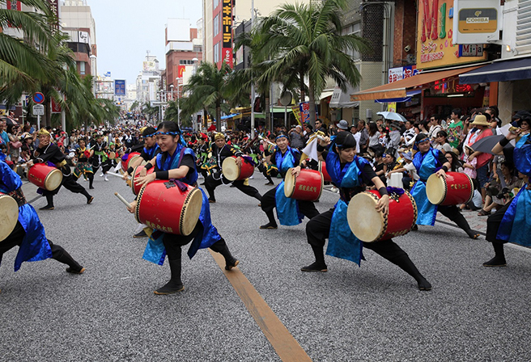
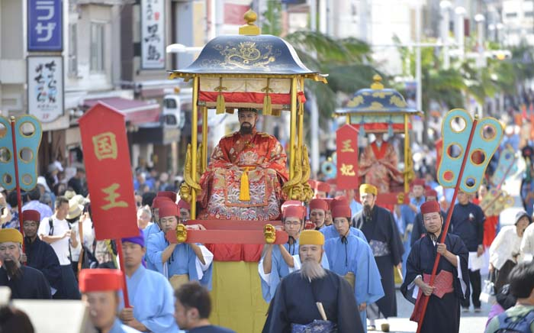
Invasion of Japan
Events
Independent from Japan until 1872
Led to the annexation of the Ryukyu Islands
Events help tell cultural histories. For those of Okinawa, events define them as a people and have ancestral meaning. Many of the events tell the stories of cultural hardship of the past and of stories related to their Ryukyu Era.
Battle of Okinawa
Itoman Great Tug-of-War
Last major battle of WW2
Turning point in the battle against the Japanese
Held on August 15th of the Lunar calendar
Done in hopes to bring a good harvest for the year
10,000 Eisa Dance Parade
Shuri Castle Festival
Held every year
Honors the first Okinawan king
Type of tradition dance and taiko drumming to send spirits back to the spirit world
Held of August 1st of every year
Notes:
The Itoman Great Tug-of-War is an event that is held on August 15th of the Lunar calendar every year and done during the harvest moon. The Great Tug-of-war is done in hopes that the harvest god will bring a good harvest and fortune for the year to come.
The Shuri Castle Festival is probably one of the more important festivals of Okinawa. It’s a celebration that's held every year to honor the enthronement of Okinawa’s first king.
Eisa is a type of dance and drumming that was done to help send of spirits back to the spirit world after they had visited for the ancestral Bon Festival. The 10,000 Eisa Dance Parade takes place on the first of August every year. Thousands participate in the Eisa tradition of dance and taiko drumming in Okinawa.
A significant event of the historical nature was the Battle of Okinawa. This battle was a major turning point in the war against the Japanese. Many people lost their lives on the island of Okinawa. For the American’s, taking control Okinawa meant they were one step closer in winning the war.
Another event of great significance was that before Okinawa was called Okinawa, they were the Ryukyu islands. They were independent from Japan and had strong trading relations with China. Japan eventually led an invasion on the islands and annexed them making them as we know today, Okinawa.

Slide 6
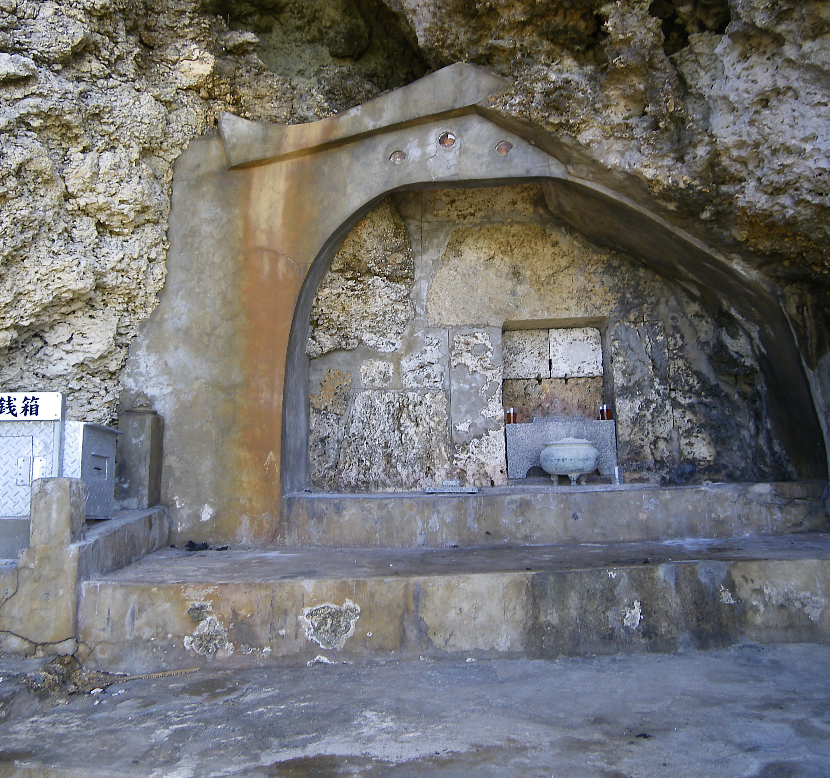
Creation Story
Nirai Kanai a world where everything originates and the gods live
The Heavenly Emperor lived in Nirai Kanai
He noticed no islands where on the Earth below
Ordered the creation of islands
Amamikyo was the goddess chosen to create new lands
Tomb of Amamiko
Notes:
Before Okinawa was annexed as part of Japan, it was known as the Ryukyu Islands. The Ryukyu Island creation myth tells the story of how the islands were created and the goddess who created them.
Nirai Kanai is believed to be a world of its own. Nirai Kanai is not of our own and known as the Other World. Nirai Kanai is where the gods live and everything begins and originates. This is where the Heavenly Emperor lives, and one day he noticed something about the world below. There were no islands. Thus the Heavenly Emperor decided to make it happen and have them created. Amamikyo was the goddess that the Heavenly Emperor ordered to create islands.

Slide 7
Creation Myth cont…
Amamikyo began constructing the islands
She required certain materials to be brought to her
Shinerikyu, a god, fetched materials such as grass, stones, and trees
Upon completion of the newly created islands, Amamikyo descended on her creation
Amamikyo needed to populate the islands, but no other gods would come down to help
Shinerikyu and Amamikyo populated the islands together, though not through intercourse
Their Heavenly Grandchild was born
His children split the island into 5 separate classes
Notes:
As she began creating the Ryukyu Islands, she needed materials. Shinerikyu, a god, was then sent to fetch materials such as grass, stone, and trees. She continued to mold and create the islands, and once they were done, Amamikyo descended onto her creation. After she was on the islands, she needed to create people to inhabit them. However, there were no gods willing to join her on the newly created Ryukyu Islands. Without intercourse, Shinerikyu impregnated Amamikyo, and they were able to populate the lands together.
Among those people that were created, was the Heavenly Grandchild. This grandchild had children of his own, and with those children, he split the Ryukyu islands into five separate classes. His children became the first Ryukyu King, the first feudal lord, the first farmer, the first royal priestess, and the first village priestess.

Slide 8
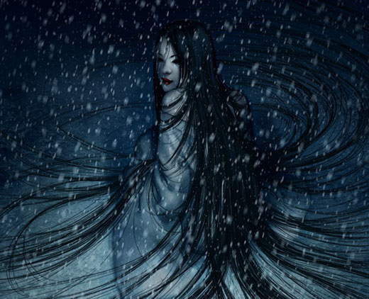
The “Others”
Evil spirits or ghosts are Okinawa’s main type of “others”
Evil spirits can manifest from nearly anything
They try to impede on everyday lifestyle
Rituals are preformed to cleanse evil spirits
Shisa guards are a prominent figure to ward off evil spirits
Notes:
For the people of Okinawa evil spirits are their “others”. These evil spirit attempt to impede on the people’s every day way of life in any way that it can. Evil spirits are able to manifest themselves from nearly anything. If you can’t sleep at night, you may have an evil spirt laying on you. If you get sick after eating, an evil spirit may have contaminated your food. The people employ certain rituals and lifestyle ways to protect themselves from the evil spirits that would do them harm. These evil spirits define the Okinawans as they are an integral part of who they are as a people.

Slide 9
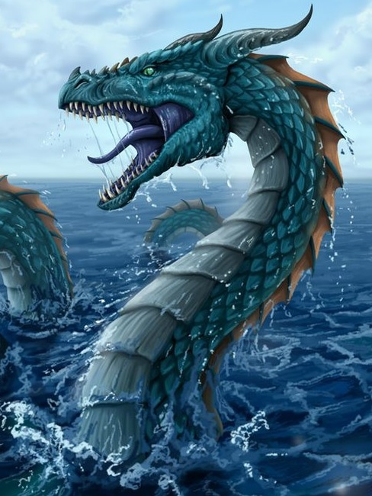
A Myth of Heroism
Chinese emissary visits Ryukyu King
The Chinese emissary offers gift of shisa to the King
The village of Madanbashi is attacked by an evil sea dragon
The Madanbashi priestess has a dream of the King defeating the sea dragon with the shisa
Priestess sent a note to the king telling of the sea dragon attack
Notes:
Long ago, in the Ryukyu kingdom, there lived a king who ruled the lands. One day the king had a feast for a very important guest. A Chinese emissary had traveled to Ryukyu to visit the king. After a lot of business talk, the Chinese emissary gave the king a gift out of good faith. The Chinese emissary called it a lion-dog and that it would protect him. The Ryukyu king was honored to receive such a gift and called it a “shisa”. The king loved the gift so much that he wore it under his clothing.
Nearby in the coastal town of Madanbashi, a monstrous sea dragon was terrorizing the village and its people. The people lived in fear of when the sea dragon might attack the village next. One night in the village, the local priestess had a dream. She dreamt about the shisa guardian and the Ryukyu king. She saw the king stand and face the sea dragon while holding up the shisa to challenge it. The priestess woke and quickly wrote down in a note what she saw in her dream and addressed it to the king. She then sent for a messenger who made his way to the king's palace.

Slide 10
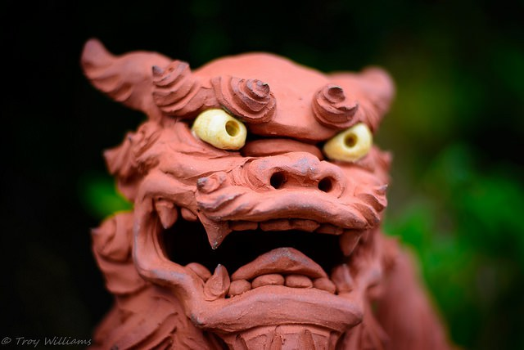
A Myth of Heroism cont…
Ryukyu King reads the priestess’ note
The king travels to Madanbashi to fight the sea dragon
The sea dragon tries to attack the king
The little shisa figure protects the king by letting out a tremendous roar
A large boulder falls from the Heavens and pins the evil sea dragon where the dragon dies
Notes:
Upon reading the priestess’ note, the king was displeased and angry that one of his villages was being terrorized. The king knew it was his duty to go to the village of Madanbashi, and try to defeat the evil sea dragon. Thus, he set out for the village with the shisa around his neck. Once he arrived and the village, he saw the fear in the villagers and the damage the sea dragon had done. Not long after the king arrived, the sea dragon showed himself ready to do more damage to the village.
The Ryukyu king made his way to the sea dragon and stood in his path to the village. The king recalled the priestess’ note and took out the shisa guardian and held it up to the sea dragon. Just as the sea dragon was about to attack the king, the shisa let out a loud roar. The roar was so fierce that it shook the ground and stunned the attacking sea dragon. The roar echoed through the heavens and a giant boulder fell from the sky, landing on the sea dragon's tail. With the boulder on his tail, the sea dragon was unable to move and ended up dying, and the small coastal village was saved.

Slide 11
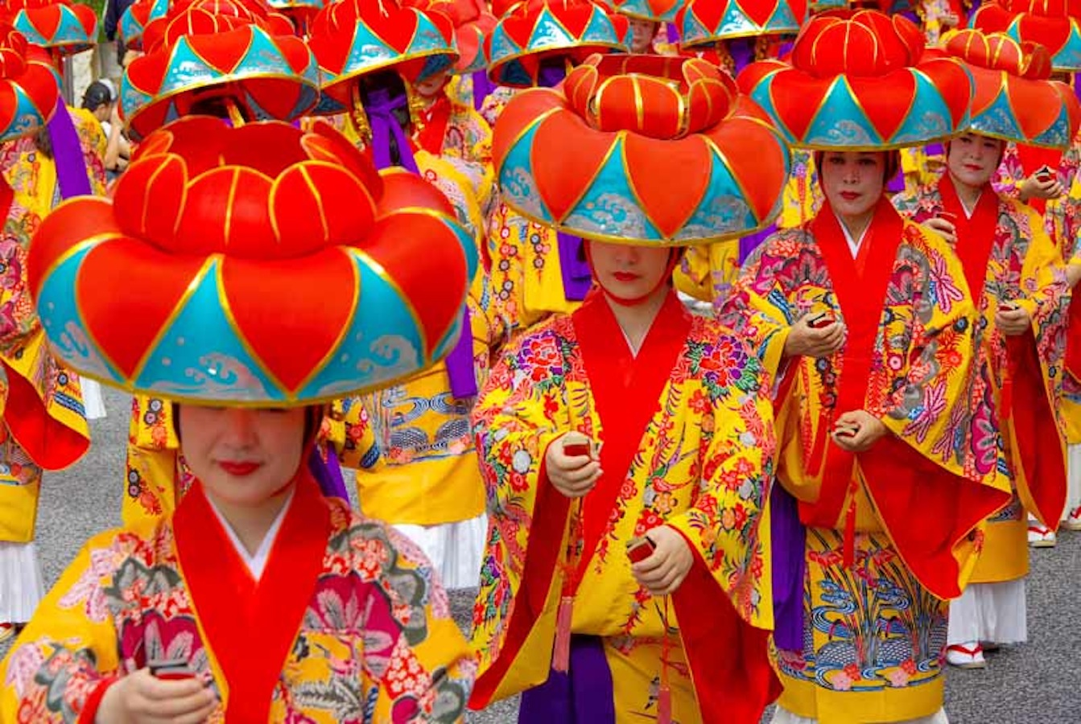
Hope for the Future
Keeping ancestral traditions alive
Not losing their identity over time or through other cultures
Good triumphs over evil
No matter the challenge, stand up and face it head on
Notes:
The myth of heroism shows the courageous acts of the ruler. He was called upon and made it his duty to go to the village that was being attacked by the sea dragon. With the help of his protector shisa, they stood up before the sea dragon and defeated it, saving the village. These actions done by the king, gave hope to many people that you should stand up against evil. And that a future worth hoping for, is a future where good triumphs over evil. That hopeful future can be seen all over Okinawa today, as the shisa guards are found everywhere and are still continuing to protect the island against evil.
To this day traditional rituals are done with the hope of preserving their ancestral ways and keeping that connection to the Ryukyu Era.

Slide 12
Conclusion
Objects are an important part of Okinawa’s material culture
Events of the past and present define the identity of the Okinawans and help the current era keep ties with their ancestral Ryukyu past
Okinawa’s “others” take the form of evil spirits that can manifest from nearly anything
Shisa guards are the main protectors of the island and from evil spirits
Their hope for the future is that their identity will not be lost with the times, as some traditions are dying out, and that future generation will continue to hold on to ancestral values

Slide 13
Works Citied
"The Okinawa Centenarian Study : Evidence Based Gerontology." Okicent.Org, 2017, http://www.okicent.org/study.html.
"Okinawa, Ikigai, And The Secrets To Longevity." Ikigai Way | Martial Arts Blog, 2017,
http://www.ikigaiway.com/2010/okinawa-ikigai-secrets-to-longevity/.
Buettner, Dan. “These People Live Longer Than Anyone. Here Are 9 Things They Do.” Mindbodygreen, 7 July 2014, www.mindbodygreen.com/0-14305/these-people-live-longer-than-anyone-here-are-9-things-they-do.html.
Mansfield, Stephen. "Food For Thought: A Traditional Okinawan Diet May Help Prolong Life | The Japan Times." The Japan Times, 2017, https://www.japantimes.co.jp/life/2015/12/12/lifestyle/food-thought-traditional-okinawan-diet-may-help-prolong-life/#.WdkrEWiPJPY.
"Early History Of The Ryukyu Kingdom And Its Relationship With China And Japan." Uchinanchu.Org, 2017, http://www.uchinanchu.org/uchinanchu/history_early.htm.
"The Great Tugs-Of-War | Be.Okinawa." Be.Okinawa, 2017, https://www.visitokinawa.jp/attractions/great-tugs-war.
"Hinukan Watches Over Family Fortunes | Japan Update." Japanupdate.Com, 2017, http://www.japanupdate.com/2013/11/hinukan-watches-over-family-fortunes/.
"Magiri-Zu - Samuraiwiki." Wiki.Samurai-Archives.Com, 2017, https://wiki.samurai-archives.com/index.php?title=Magiri-zu.
"Okinawa Index: Index > Culture > Myth & Folklore > Ishiganto." Okinawaindex.Com, 2017, http://www.okinawaindex.com/index/?tid=2&cid=290&id=2.
"Okinawa Index: Index > Culture > Myth & Folklore > Shisa." Okinawaindex.Com, 2017, http://www.okinawaindex.com/index/?tid=2&cid=290&id=1.
"Ryukyu Investiture Crown - Samuraiwiki." Wiki.Samurai-Archives.Com, 2017, https://wiki.samurai-archives.com/index.php?title=Ryukyu_investiture_crown.
"Shuri Castle Festival - Where Japan's Ancient History Gets Revived." Annees De Pelerinage, 2017, http://www.annees-de-pelerinage.com/shuri-castle-festival-naha-okinawa/.
"Shuri Castle's Other History: Architecture And Empire In Okinawa | The Asia-Pacific Journal: Japan Focus." Apjjf.Org, 2017, http://apjjf.org/-Tze-M.-Loo/3232/article.html.
"國學院デジタルミュージアム." K-Amc.Kokugakuin.Ac.Jp, 2017, http://k-amc.kokugakuin.ac.jp/DM/detail.do;jsessionid=A3C4B0988A436CB584C4F244A906904A?class_name=col_eos&data_id=23243.
Girl, Mensore. "The History Of Eisa: Okinawa's Folk Dance - Mensore Girl." Mensore Girl, 2017, http://www.mensoregirl.com/eisa-okinawa/.
Okinawa, Battle. "Battle Of Okinawa - World War II - HISTORY.Com." HISTORY.Com, 2017, http://www.history.com/topics/world-war-ii/battle-of-okinawa.
2017, https://japanesemythology.wordpress.com/nirai-kanai/.
Revolvy, LLC. ""Ryukyuan Mythology" On Revolvy.Com." Revolvy.Com, 2017, https://www.revolvy.com/main/index.php?s=Ryukyuan%20mythology&item_type=topic.
"Encyclopedia Of Shinto - Home : Rituals In Okinawa And Amami : Ryūkyū Mythology." Eos.Kokugakuin.Ac.Jp, 2017, http://eos.kokugakuin.ac.jp/modules/xwords/entry.php?entryID=1032.
Revolvy, LLC. ""Amamikyu" On Revolvy.Com." Revolvy.Com, 2017, https://www.revolvy.com/main/index.php?s=Amamikyu&item_type=topic.
"Learn About Shisa Dogs, The Fascinating Stone Guardians Of Okinawa! – Japan Info." Japan Info, 2017, http://jpninfo.com/21249.
"Okinawa Index: Index > Culture > Myth & Folklore > Shisa." Okinawaindex.Com, 2017, http://www.okinawaindex.com/index/?tid=2&cid=290&id=1.
Nieubuurt, J et al. "Ancient Guardians Of Okinawa: Shisa." Joshneebs.Blogspot.Com, 2017, http://joshneebs.blogspot.com/2014/04/ancient-guardians-of-okinawa-shisa.html.

